Slide 1

FINAL YEAR MAJOR PROJECT
SWAMI VIVEKANANDA INSTITUTE OF TECHNOLOGY
( MAHBUB COLLEGE CAMPUS, PATNY CENTER
SECUNDERABAD – 500003 )
DEPARTMENT OF CSE - DATA SCIENCE

Slide 2
A Deep Learning-Based Approach For Inappropriate Content Detection And Classification Of Youtube Videos.
TEAM MEMBERS:
P.KAUSTUBH-21P71A6728 L.NIKHIL- 21P71A6746
S.NITHIN- 21P71A6749
P.PUJITHA- 21P71A6758
Under the Supervision of Rajesh Sir

Slide 3
ABSTRACT
The exponential growth of video content on platforms like YouTube, the spread of inappropriate, misleading, or harmful videos has become a major concern for content moderators and viewers alike. Traditional detection systems often rely on user reports and basic keyword filtering, which are reactive, time-consuming, and prone to oversight. Inappropriate content, which may include hate speech, violence, misinformation, or explicit material, often manifests through subtle cues in audio, video, and textual metadata, making it challenging to detect using conventional methods. The system leverages video metadata, visual frames, and user interaction signals to detect and classify content types with high precision. By capturing both local and global inconsistencies, this model can effectively identify inappropriate elements within a video before it gains wide traction. Experimental evaluation on real-world YouTube datasets demonstrates high accuracy and reliability, proving the effectiveness of the proposed model for scalable, automated video content moderation.

Slide 4
INTRODUCTION
The explosive growth of online video-sharing platforms like YouTube, managing and moderating user-generated content has become a critical concern. The presence of inappropriate content—including violence, hate speech, nudity, and misinformation—poses serious challenges to content safety, user trust, and platform integrity. Traditional content moderation methods, relying on manual review or rule-based systems, are often insufficient due to their limited scalability and accuracy. To address these limitations, deep learning has emerged as a powerful and efficient tool for automated content analysis. This study explores a deep learning-based approach for detecting and classifying inappropriate content in YouTube videos by leveraging advancements in computer vision, natural language processing, and audio analysis. The proposed system aims to enhance the accuracy and responsiveness of content moderation, ultimately contributing to a safer digital environment for users.

Slide 5
EXISTING SYSTEM
The current YouTube content moderation system predominantly relies on user reports, manual review, and basic keyword filtering techniques to identify inappropriate content. While some rule-based algorithms are in place, they often fail to detect subtle or context-based violations such as implicit hate speech, misinformation, or suggestive content. Moreover, traditional systems lack the capacity to analyze multimodal data (video, audio, and text) in a cohesive way, leading to a significant amount of inappropriate content escaping detection. The delays in identifying harmful content can result in widespread misinformation, audience harm, or violation of community guidelines before action is taken.

Slide 6
EXISTING SYSTEM DISADVANTAGES
Heavily dependent on manual reporting and moderation
Ineffective against context-aware or disguised inappropriate content
Lack of real-time detection
High false positives and false negatives
No deep correlation between video, audio, and metadata
Cannot scale well with growing video uploads

Slide 7
PROPOSED SYSTEM
The proposed system leverages a deep learning-based framework incorporating long-distance attention mechanisms for the early detection and classification of inappropriate YouTube content. It processes multiple data sources — video frames, metadata, and engagement statistics — using a spatial-temporal model. The long-distance attention allows the system to detect subtle visual or behavioral patterns and correlate them with textual clues or historical metadata inconsistencies. By treating the detection as a fine-grained classification problem, the system is capable of recognizing nuanced violations that traditional models often miss. This enables proactive, automated flagging of harmful content, reducing reliance on human moderators and ensuring safer digital spaces.

Slide 8
PROPOSED SYSTEM ADVANTAGES
Real-time, automated inappropriate content detection
Multi-modal data analysis (video, audio, metadata)
Fine-grained classification improves detection of subtle violations
Scalable architecture for processing large video datasets
Reduced human intervention and faster response times

Slide 9
SYSTEM REQUIREMENTS
Hardware Requirements:
Processor: Intel i5 or higher (or AMD Ryzen5)
RAM: Minimum 8GB
GPU: NVIDIA GPU with CUDA support for training CNNs, LSTM, and transformer models
Hard Disk: Minimum 100 GB(SSD preferred)
Monitor: Full HD Display
Input Devices: Standard Keyword and Mouse

Slide 10
SOFTWARE REQUIREMENTS:
Operating System: Windows 7 or higher
Programming Language: Python 3.7
Libraries/Frameworks: TensorFlow or PyTorch, OpenCV, Numpy, Pandas.
Backend: Django / Flask
Database: MySQL
IDE/Editor: VS Code
Additional Tools: Jupyter Notebook, Git, XAMPP

Slide 11
MODULES
Service Provider
In this module, the Service Provider has to login by using valid user name and password. After login successful he can do some operations such as Login, Train & Test YouTube Content Data Sets, View Trained and Tested Accuracy in Bar Chart , View Trained and Tested Accuracy Results ,View Prediction Of YouTube Content Data Sets, View YouTube Content Data Sets Ratio , Download Predicted Data Sets ,View YouTube Content Data Sets Ratio Results ,View All Remote Users.
View and Authorize Users
In this module, the admin can view the list of users who all registered. In this, the admin can view the user’s details such as, user name, email, address and admin authorizes the users.
Remote User
In this module, there are n numbers of users are present. User should register before doing any operations. Once user registers, their details will be stored to the database. After registration successful, he has to login by using authorized user name and password. Once Login is successful user will do some operations like REGISTER AND LOGIN, PREDICT YOUTTUBE CONTENT TYPE, VIEW YOUR PROFILE.

Slide 12
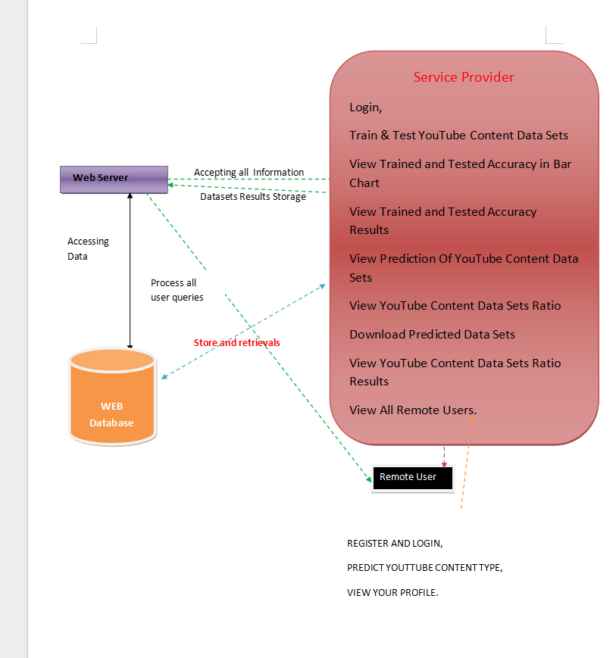
SYSTEM
ARCHITECTURE

Slide 13
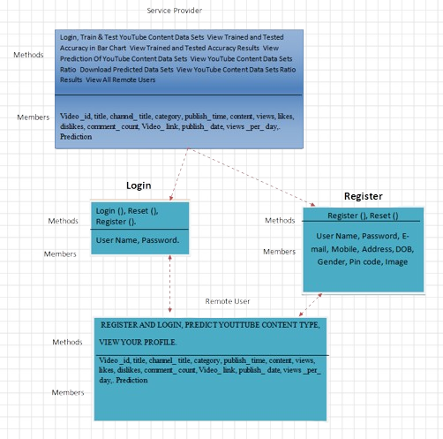
UML DIAGRAMS
CLASS DIAGRAM:

Slide 14
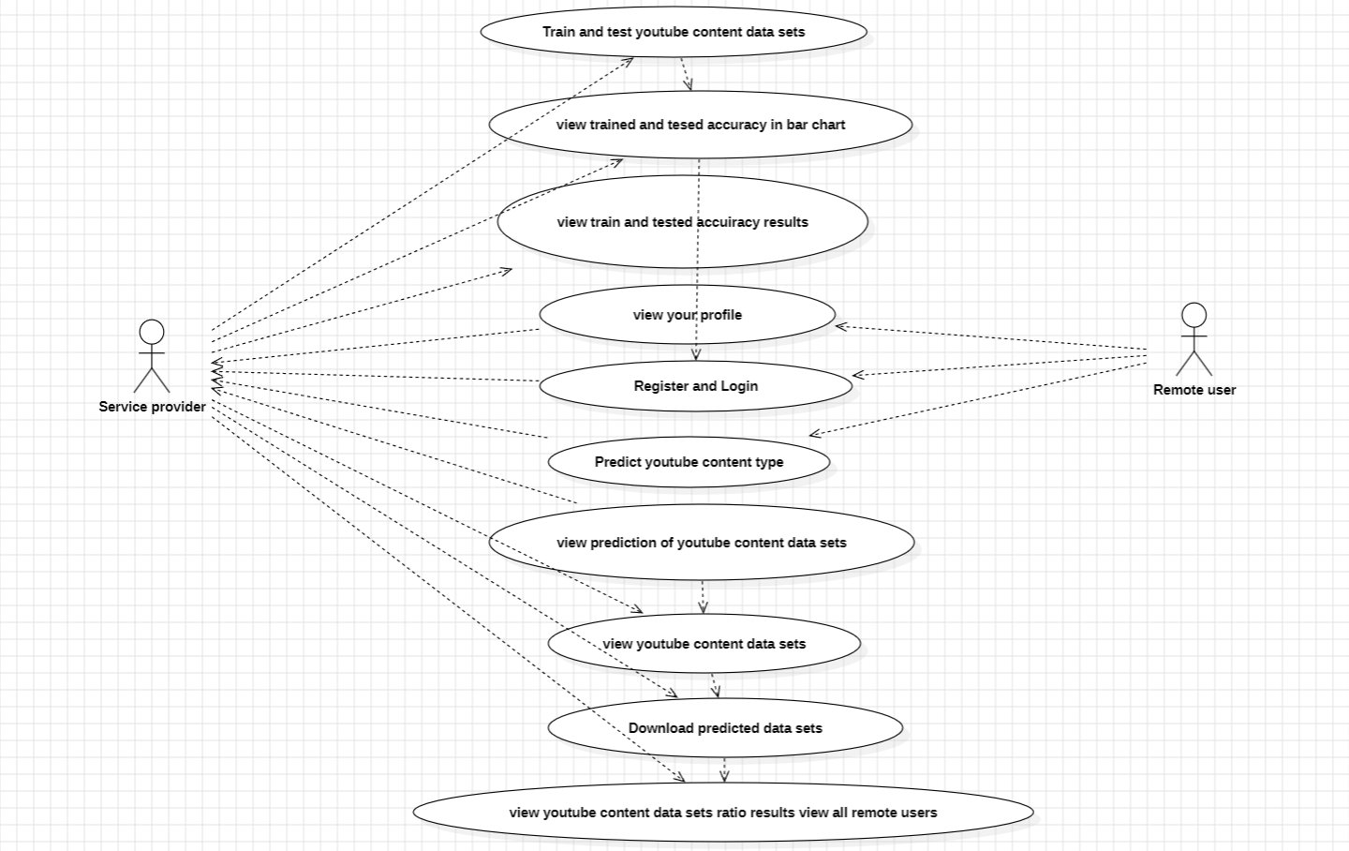
USE CASE DIAGRAM:

Slide 15
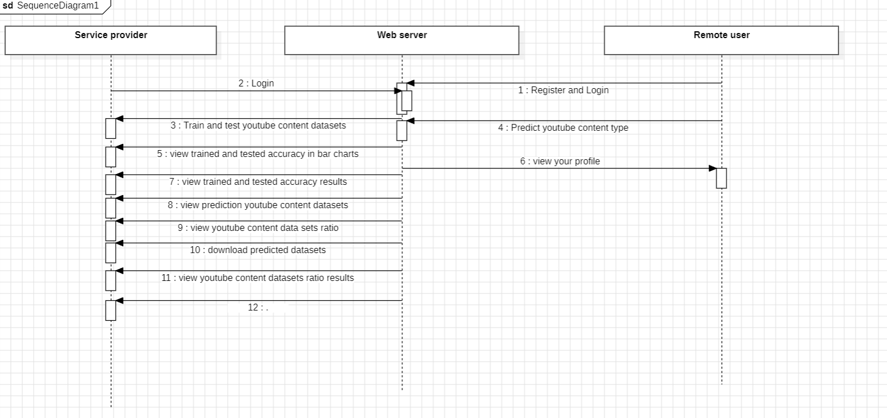
SEQUENCE DIAGRAM:

Slide 16
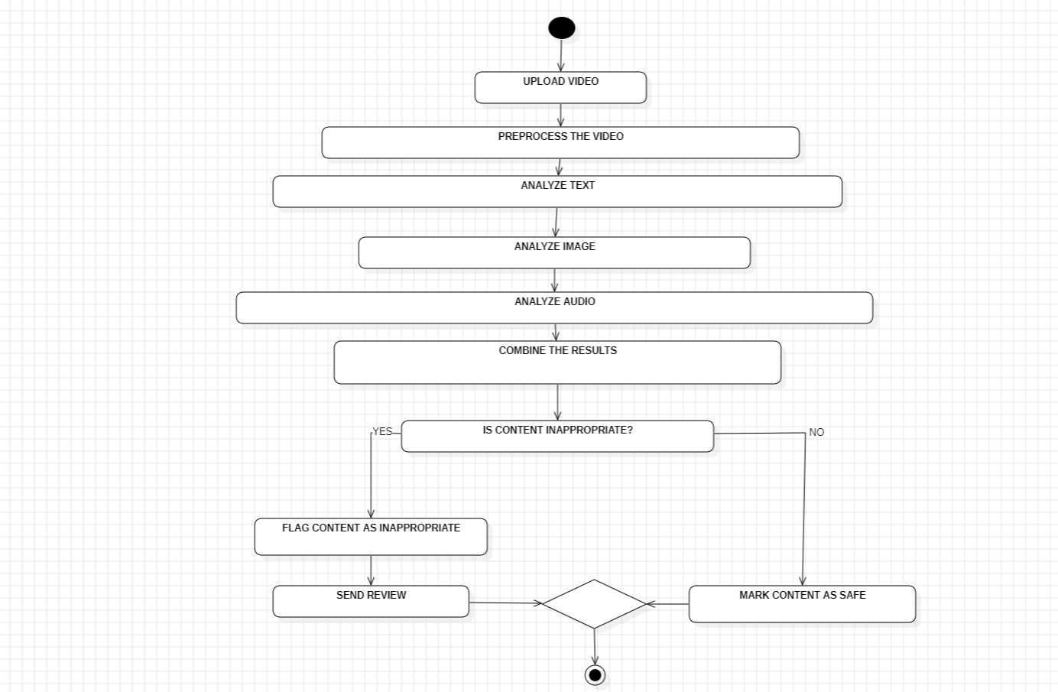
ACTIVITY DAIGRAM:

Slide 17
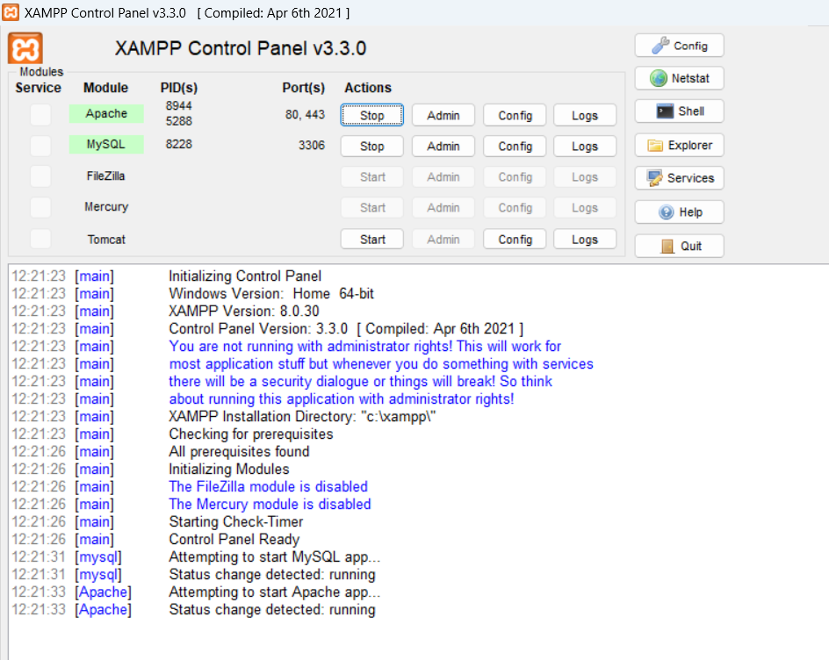
OUTPUT SCREENSHOTS

Slide 18
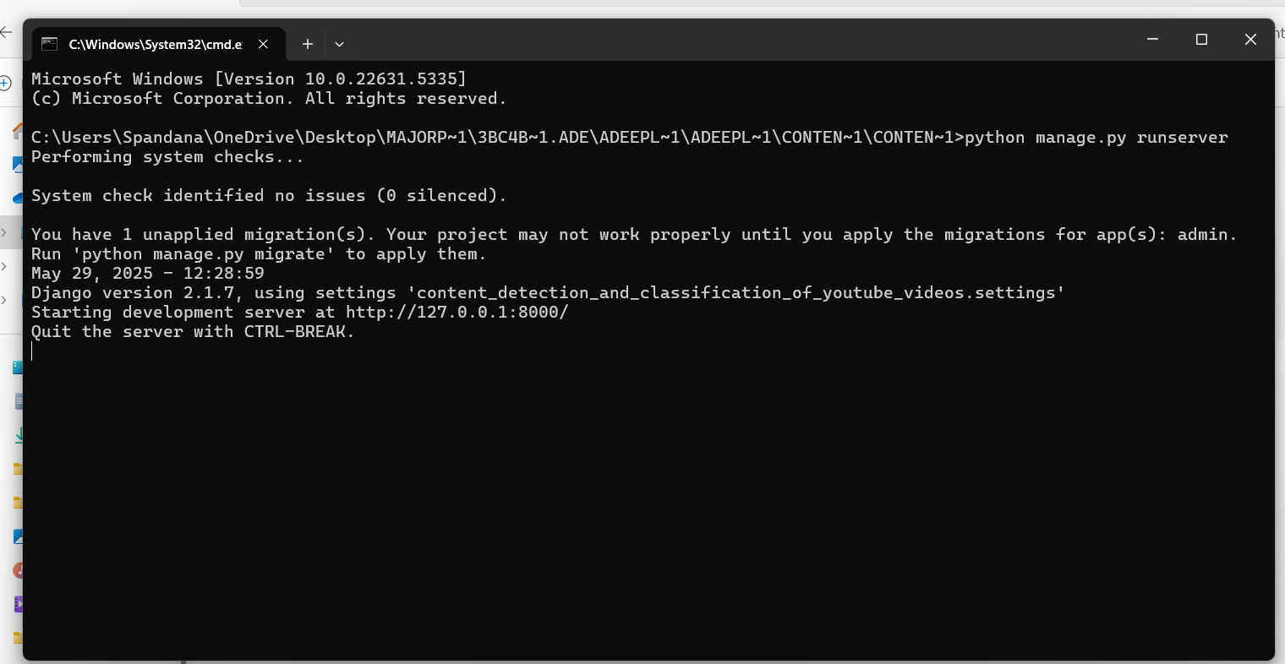

Slide 19
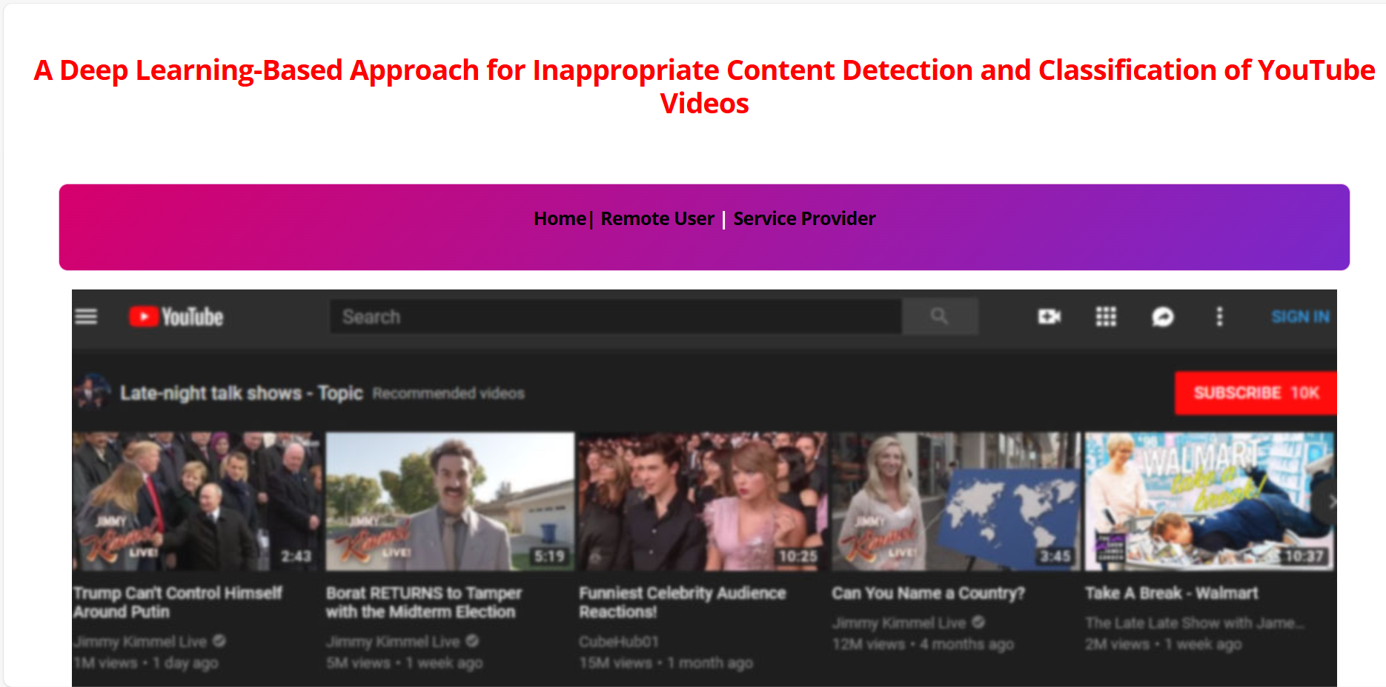

Slide 20
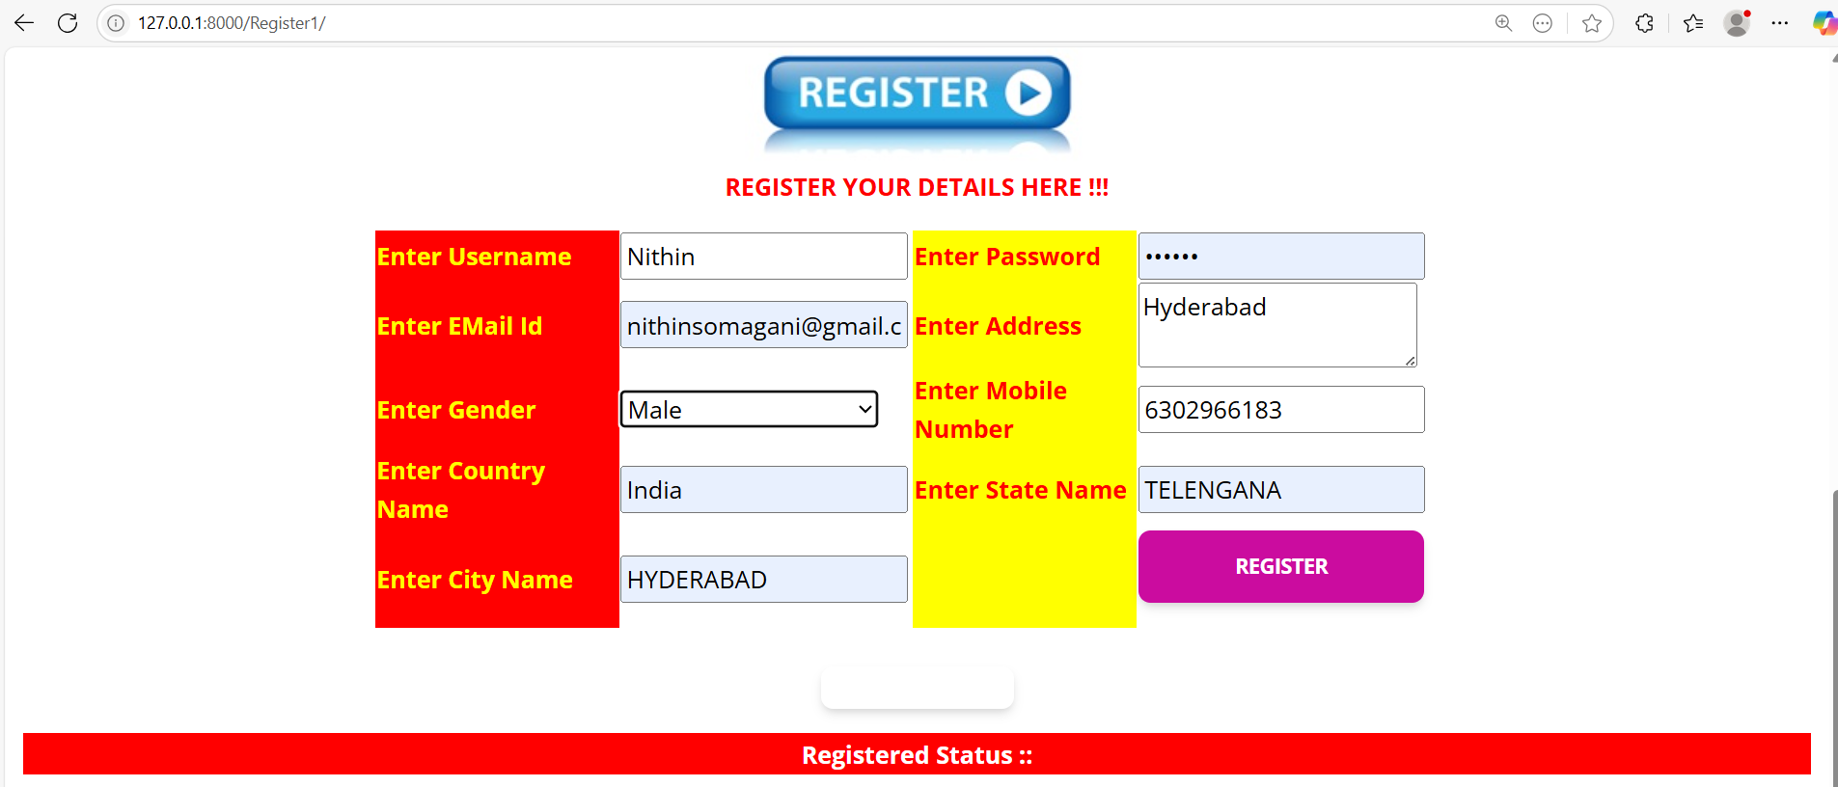

Slide 21
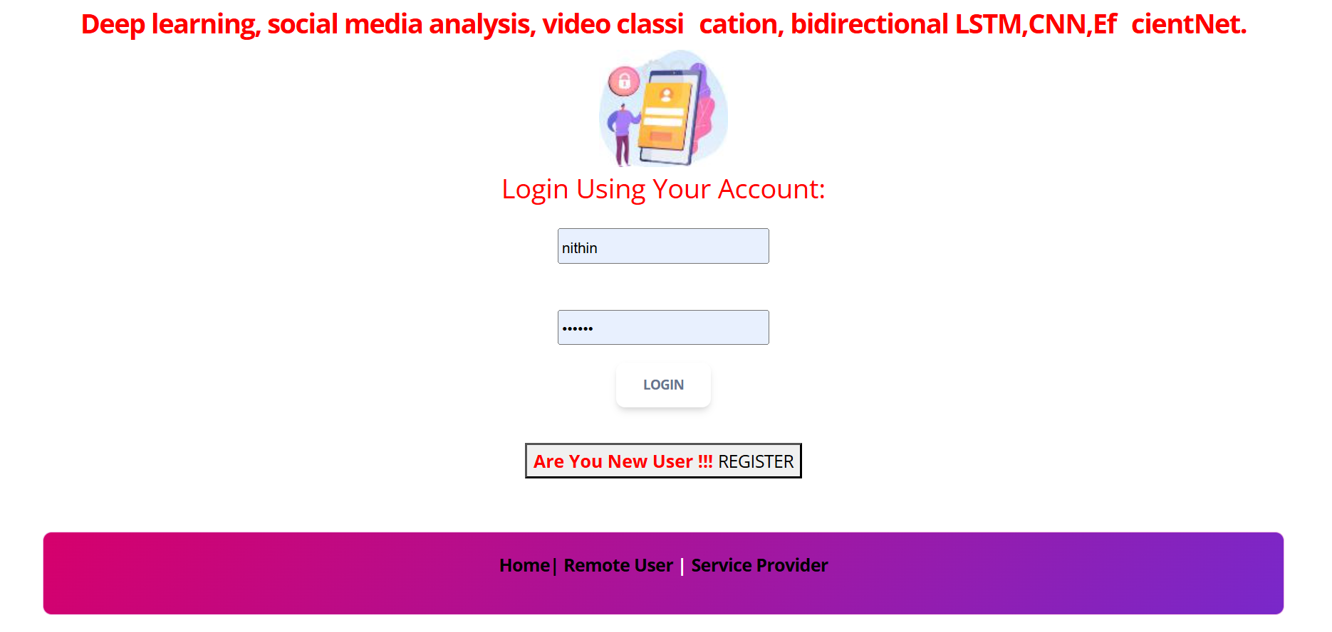

Slide 22
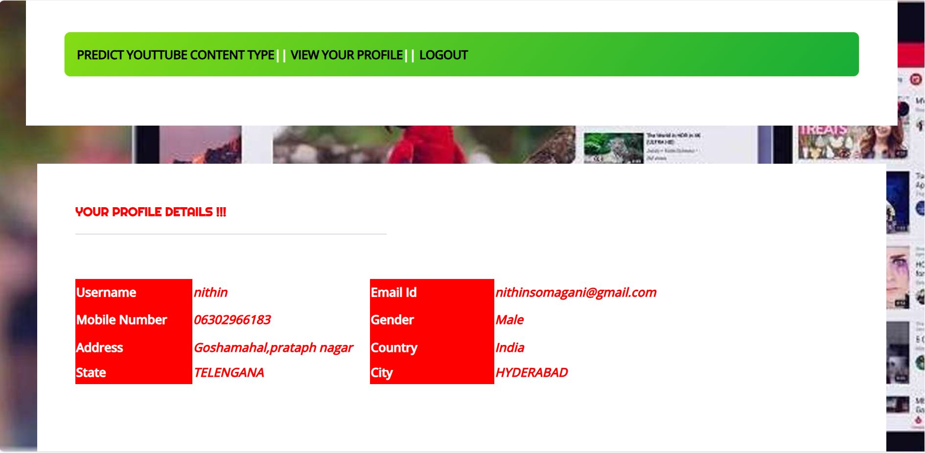

Slide 23
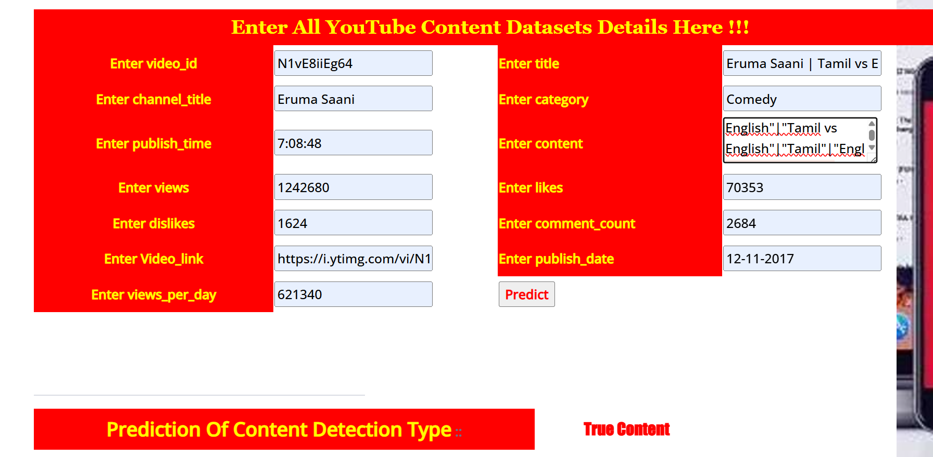

Slide 24
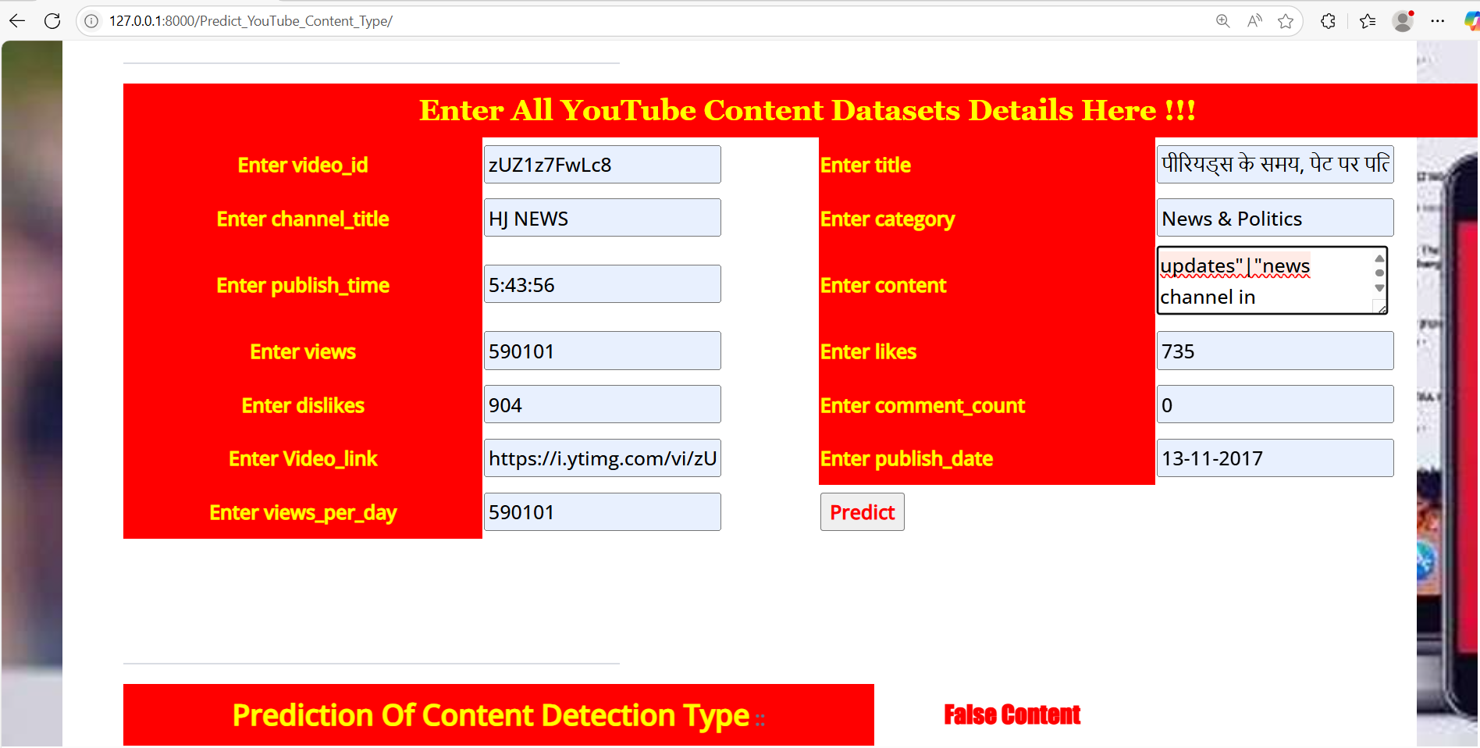

Slide 25
CONCLUSION
The deep learning-based approach for inappropriate content detection and classification of YouTube videos offers a scalable and effective solution to modern content moderation challenges. By integrating multiple data modalities—text, audio, and visuals—this system enhances accuracy in identifying harmful material such as violence, hate speech, and adult content. Leveraging advanced techniques like NLP with BERT, audio spectrogram analysis, and CNN-based image recognition, the system provides real-time, automated moderation that can assist platforms in maintaining safe and responsible digital environments. Ultimately, this technology supports safer internet use, especially for children and teens, while aiding platforms in adhering to legal and ethical standards.

Slide 26
THANK YOU!!

